Slide 1
Instalog
Jacob Snyder jrs213@case.edu
Billy O’Neal bro4@case.edu
Notes:
Jacob

Slide 2
Introduction
Log everything on a Windows machine
Registry
Files
Processes
Etc.
Why? (New) viruses!
Notes:
Jacob

Slide 3
History
Started with HJT by Merjin Bellekom
Left unmaintained by TrendMicro
Deckard’s System Scanner by Deckard
TDSS commandline bug
Today’s Jungle
OTL / OTS / OTA
DDS (Doesn’t Do Squat)
Notes:
Bill

Slide 4
Target Users
Joe User
Johnny Power-User
Jacob “Forum” Expert
Notes:
Jacob for the first – Bill for the second two

Slide 5
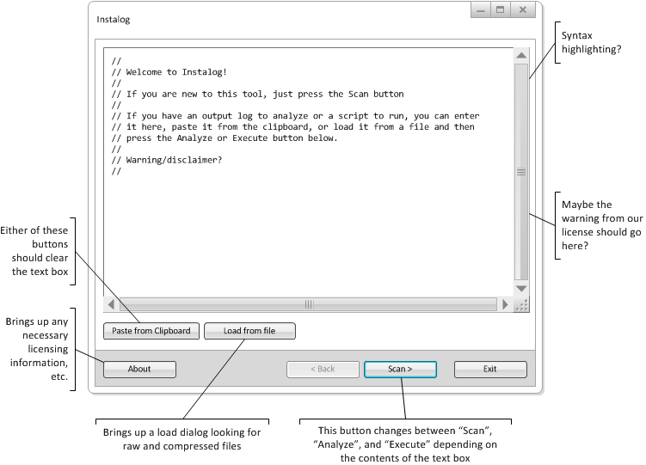
Main Screen

Slide 6
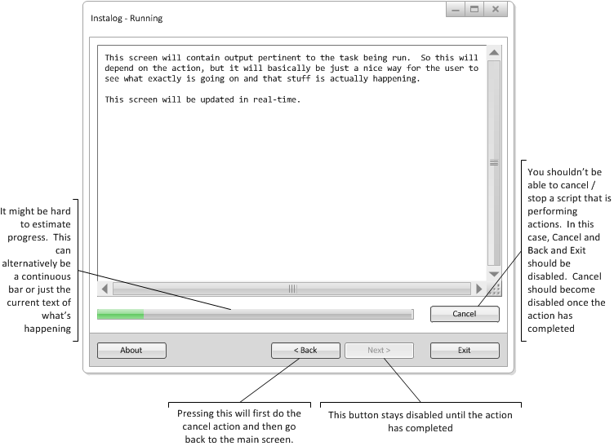
Scan or Fix Running

Slide 7
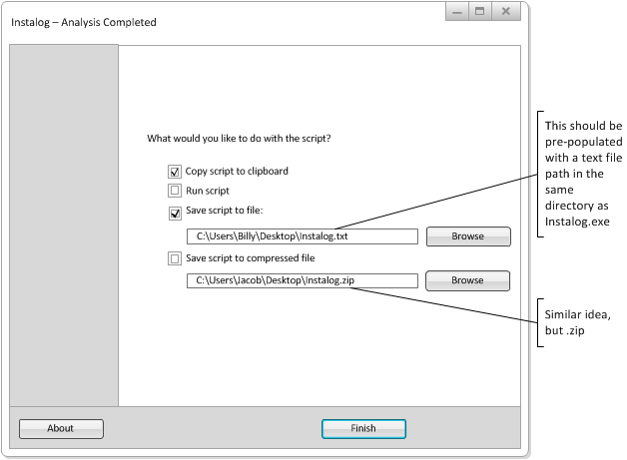
Save

Slide 8
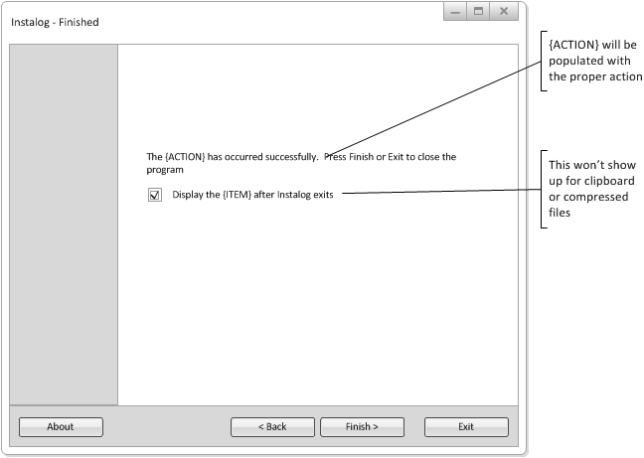
Finished

Slide 9
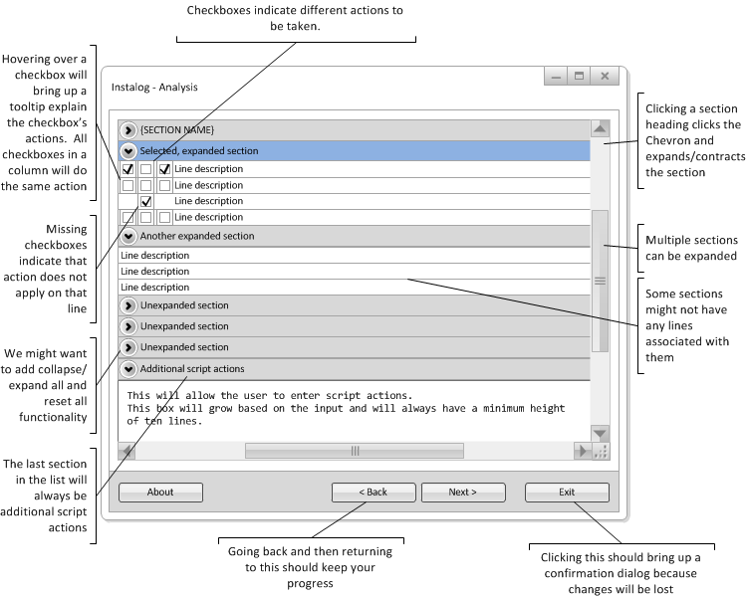
Analysis

Slide 10
Other Tools Demo
Hijack This
OTS / OTA

Slide 11
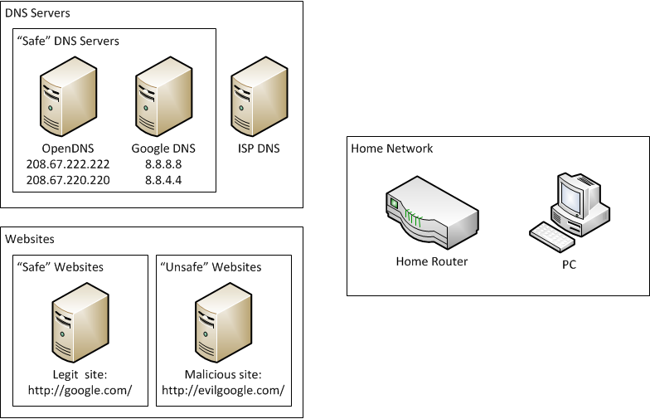
DNS “Hijack” Scenario

